Slide 1

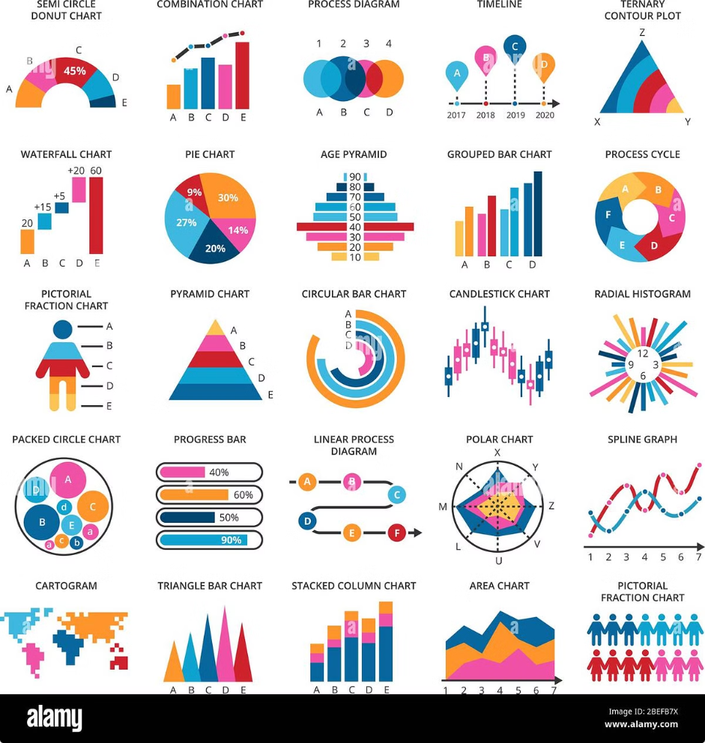
Real-Time Fraud Detection
This presentation outlines the development of a real-time fraud detection system for financial transactions using machine learning. The project aims to identify and prevent fraudulent activities in financial transactions by leveraging advanced machine learning algorithms.
Team Members: Luxmi Rana ,Ayush Sharma, Shraman, Nitesh, Shadman

Slide 2
Project Objective
The objective of this project is to create a real-time fraud detection system for financial transactions using machine learning.
Goal
Approach
To develop a system that can identify and prevent fraudulent activities in financial transactions.
Leveraging advanced machine learning algorithms to analyze transaction data and detect suspicious patterns.

Slide 3
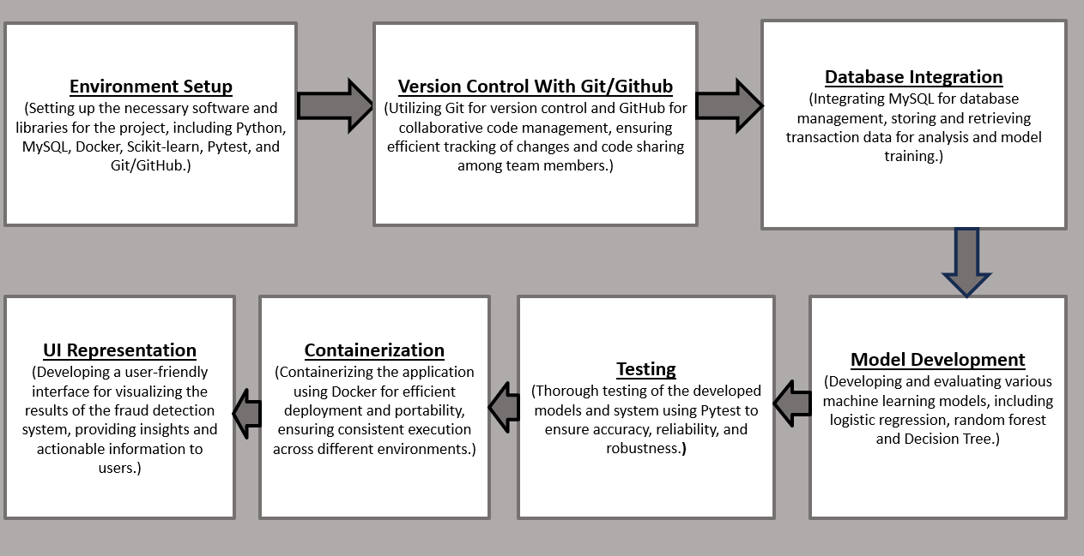
Project Workflow

Slide 4
Tools and Technologies
Python (pandas for data manipulation)
MySQL (for database management)
Docker (for containerization)
Scikit-learn (for machine learning models)
Pytest (for testing)
Git/GitHub (for version control)
Streamlit (for UI)

Slide 5
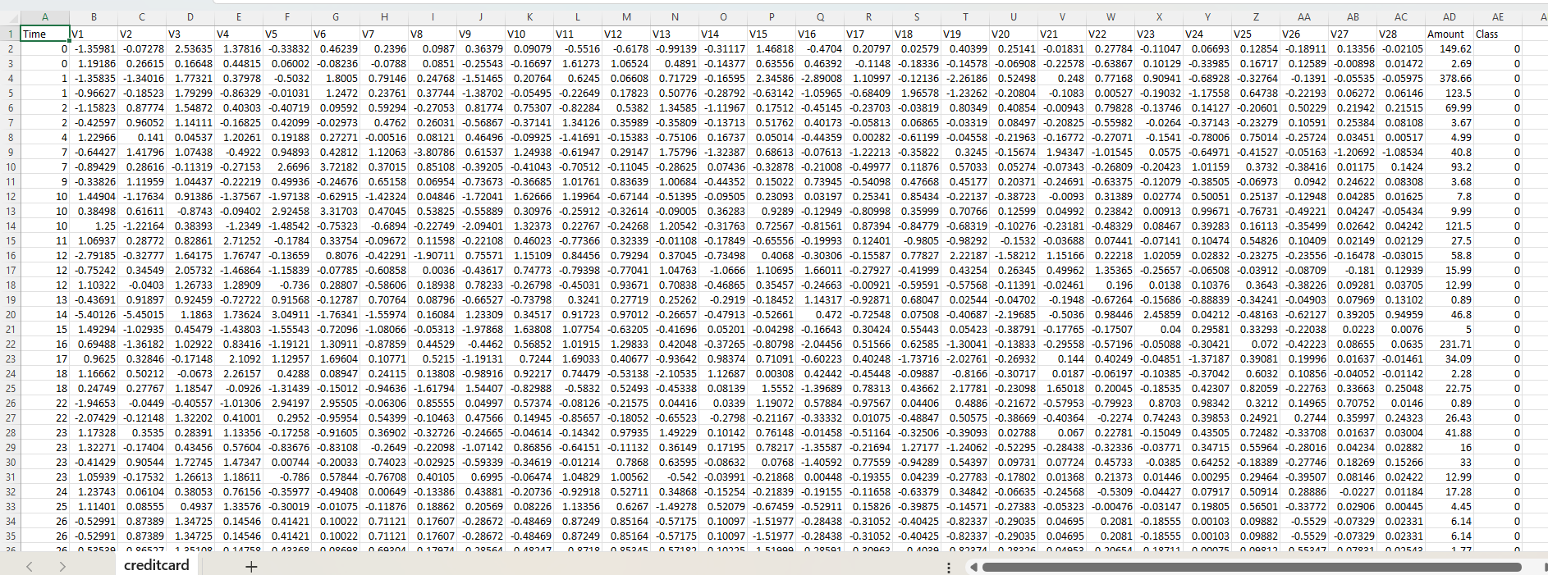
Dataset
We used the Credit Card Fraud Detection Dataset from Kaggle.
Features V1, V2, … V28 are the principal components obtained with PCA. Feature 'Time' contains the seconds elapsed between each transaction and the first transaction in the dataset. The feature 'Amount' is the transaction Amount. Feature 'Class' is the response variable and it takes value 1 in case of fraud and 0 otherwise.
https://www.kaggle.com/datasets/mlg-ulb/creditcardfraud

Slide 6
My Contributions
Installation of required software
Created GitHub repository
Installing the necessary software and libraries for the project, including Python, MySQL, Docker, Scikit-learn, Pytest, and Git/GitHub.
Created the GitHub repository for the project, providing a centralized platform for collaborative code management and version control.
Integrated MySQL database
Built models (mainly Decision Tree and also tested Random Forest and Logistic Regression)
Different Machine Learning Models gave different accuracy
Integrated the MySQL database, enabling the storage and retrieval of transaction data for analysis and model training.
Performed basic analysis and data visualization using python libraries
Containerized the application with Docker and pulled the web app from Docker Hub
Conducted basic analysis of the dataset and worked on data visualization using Matplotlib and Seaborn.
Containerized the application using Docker and pulled the Credit Card Fraud Detection web app using docker hub

Slide 7

Contributions of Other Members
Sharaman
Installation, GitHub repo creation, MySQL integration, oversampling, code merging, UI development
Nitesh
Installation, GitHub repo creation, MySQL integration, and testing with Pytest
Shadman
Installation, GitHub repo creation, MySQL integration, random forest model development, data analysis, Docker containerization
Ayush
Installation, GitHub repo creation, MySQL integration, undersampling, Logistic regression ML model, Docker containerization

Slide 8
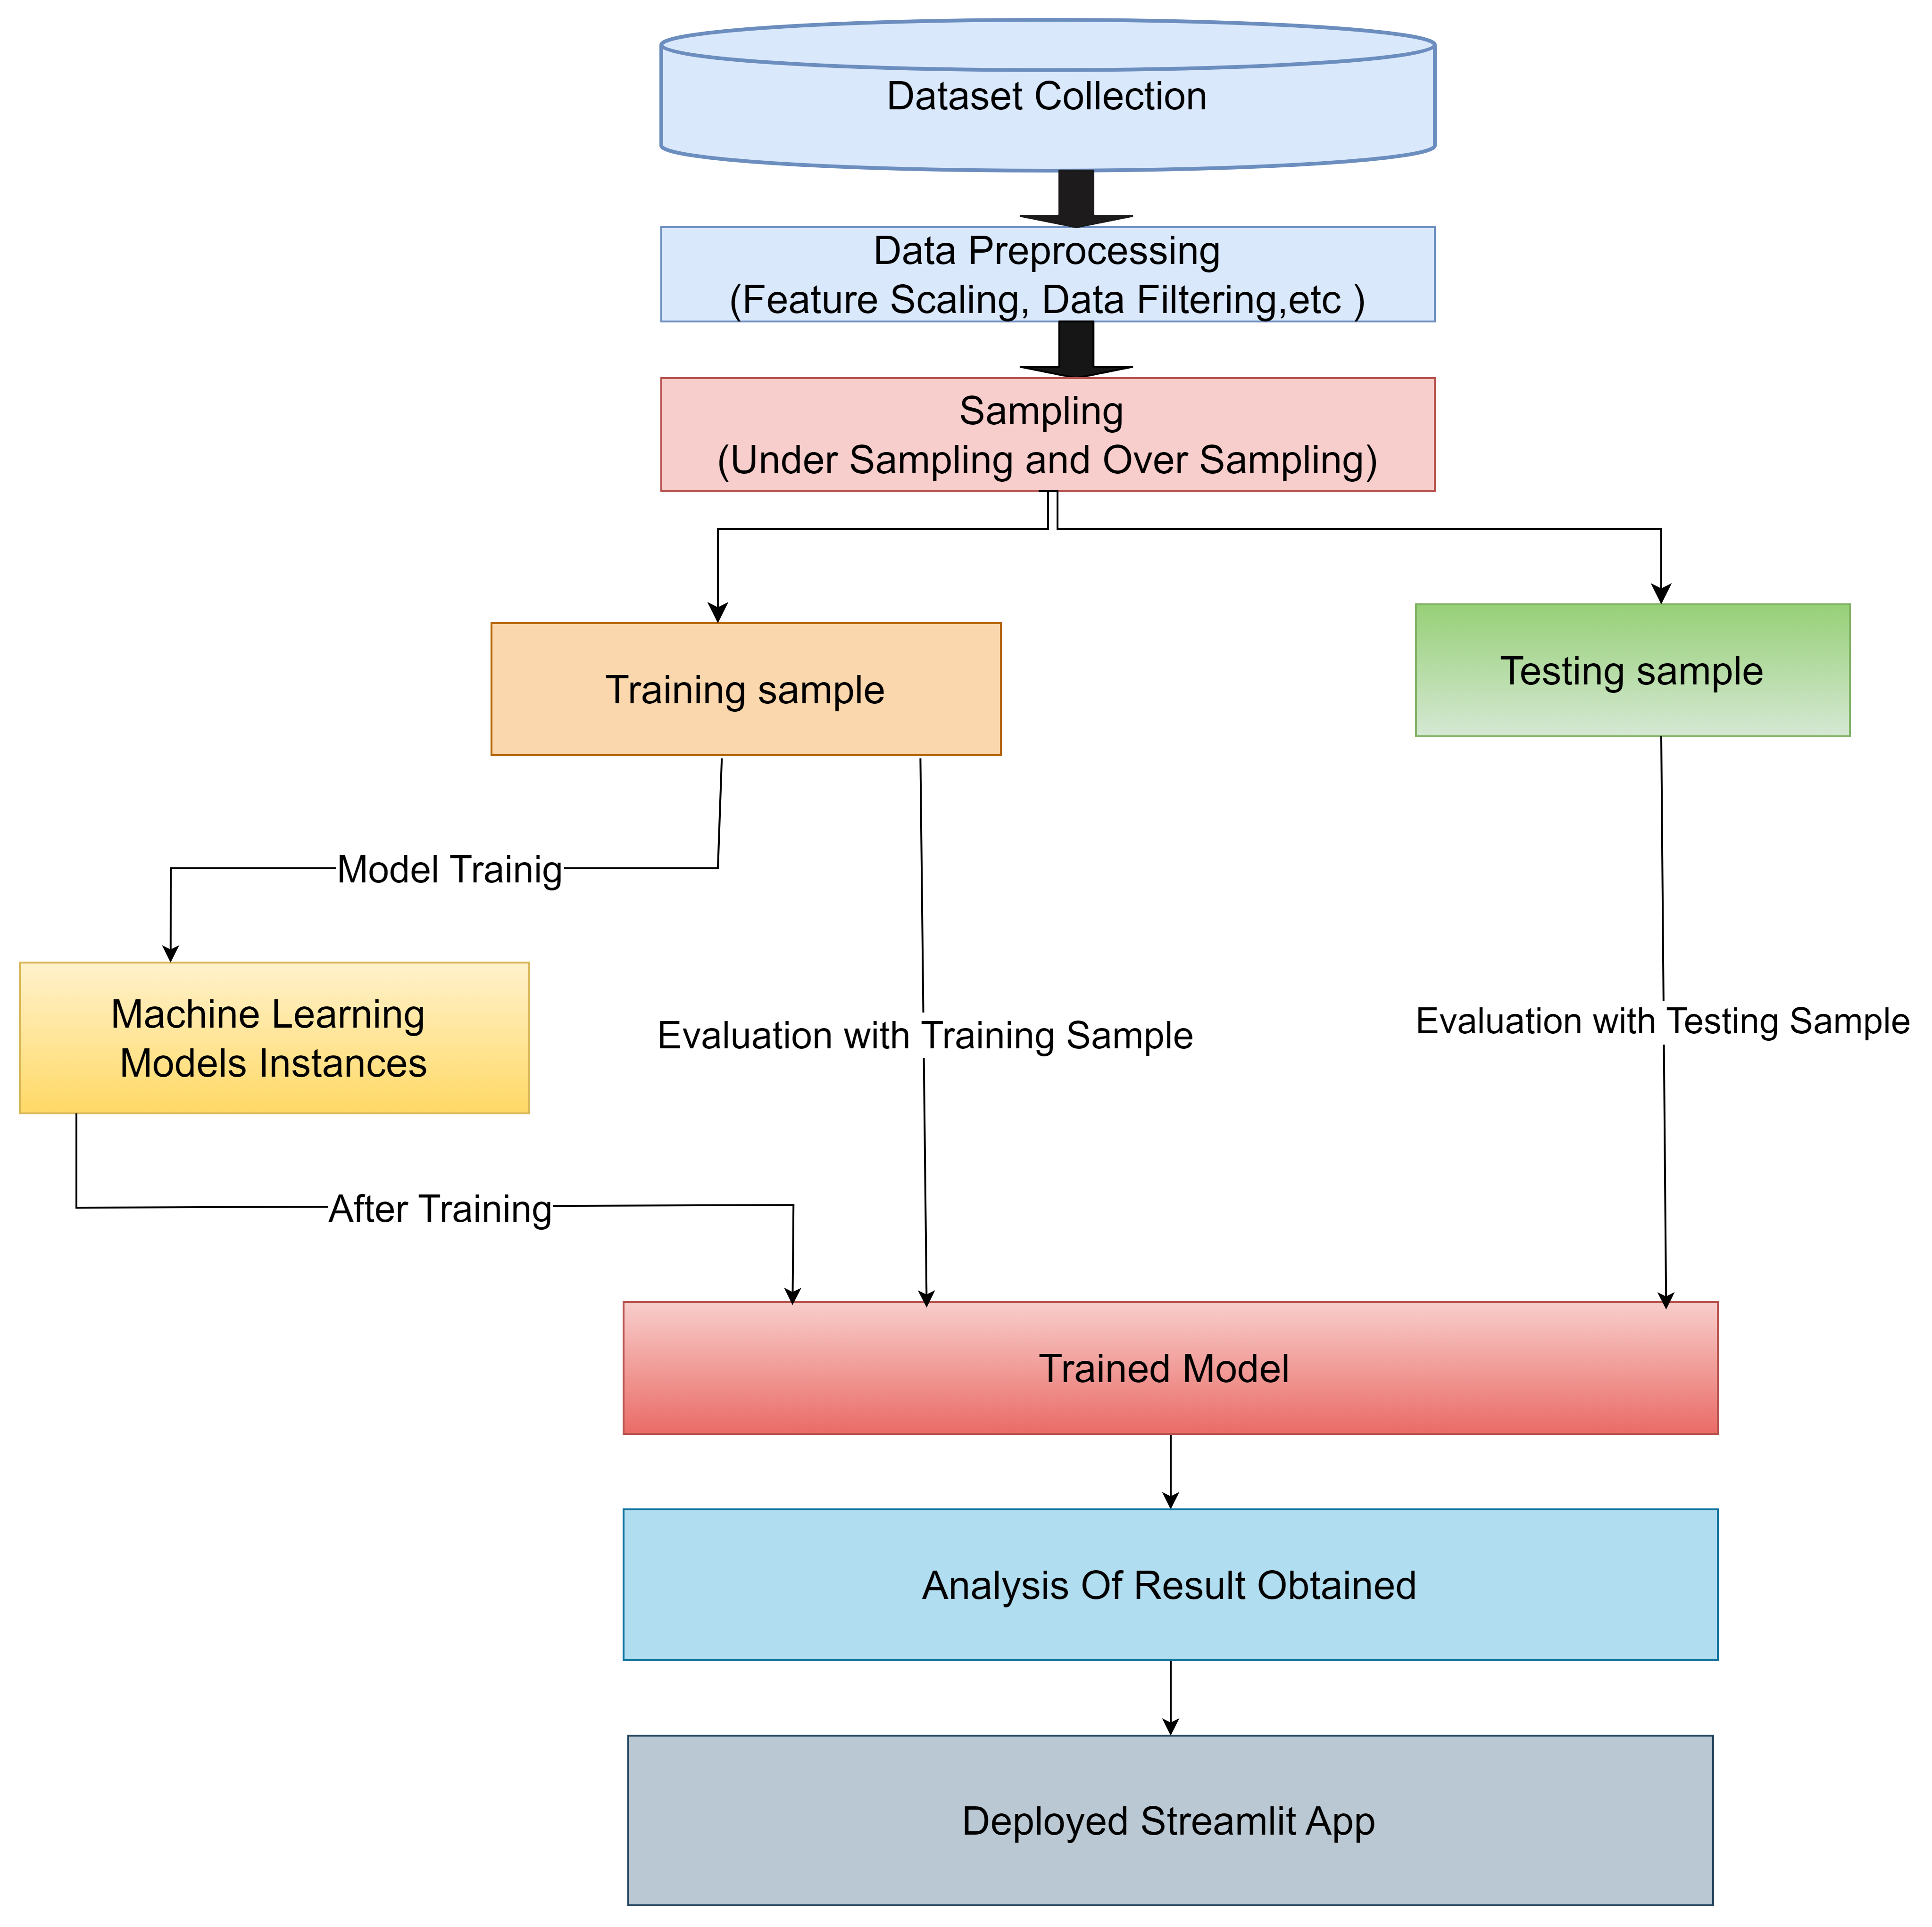
Flowchart for the process

Slide 9
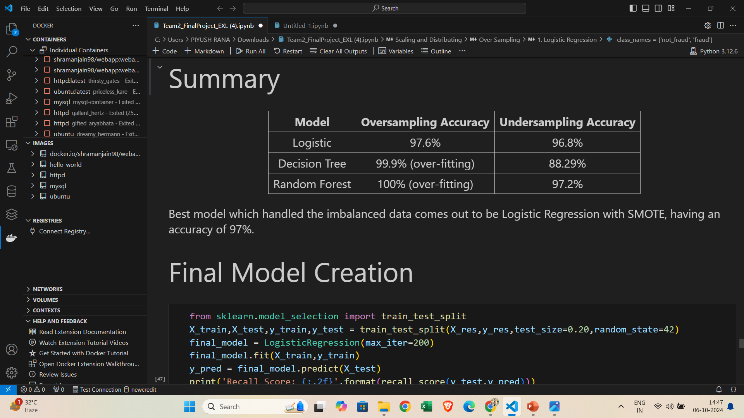
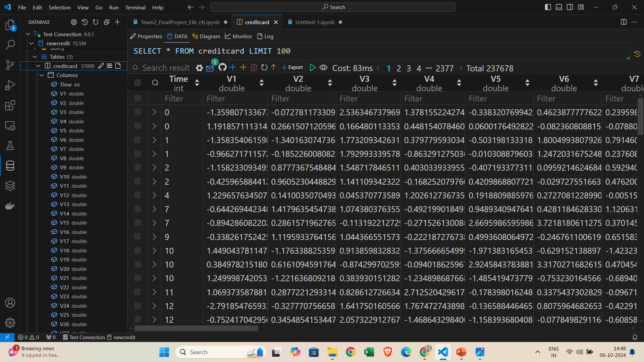
Images of Project
Docker in VS Code
Mysql Docker Container in VS Code :

Slide 10
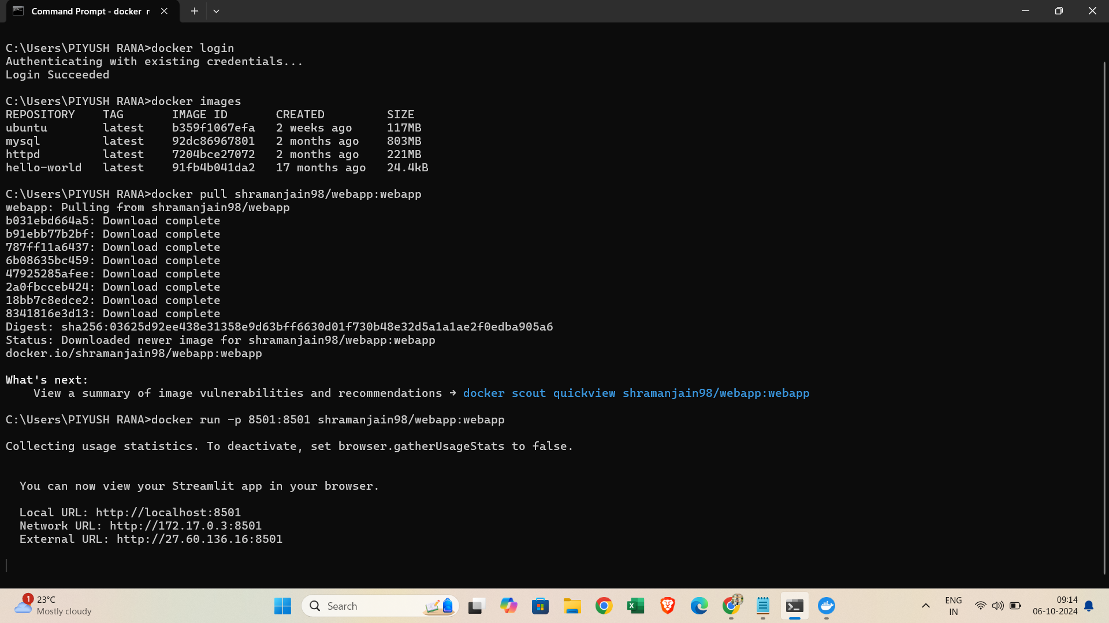
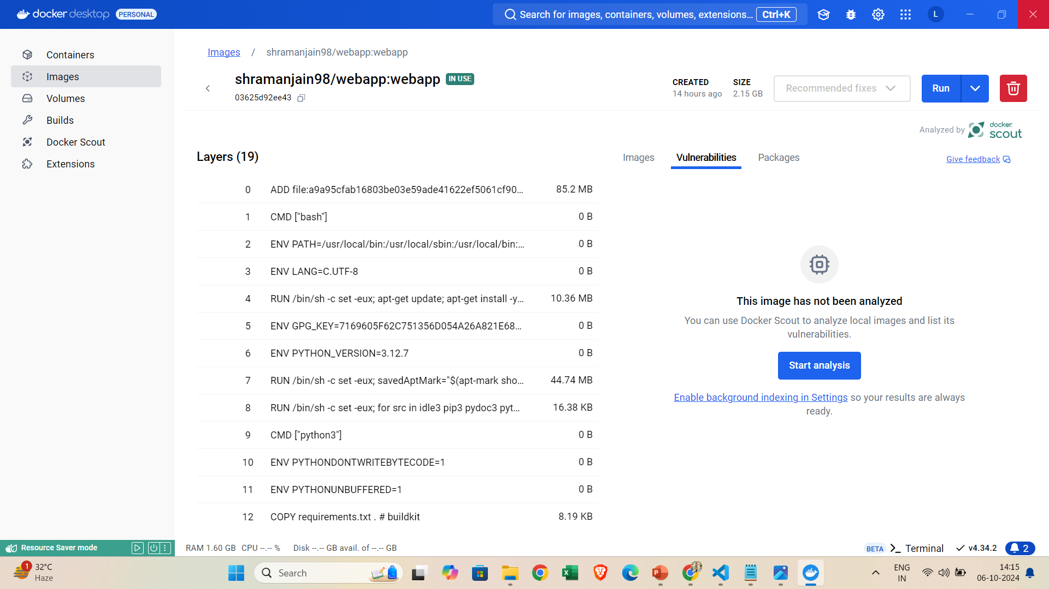
Images of Project
Docker Image

Slide 11
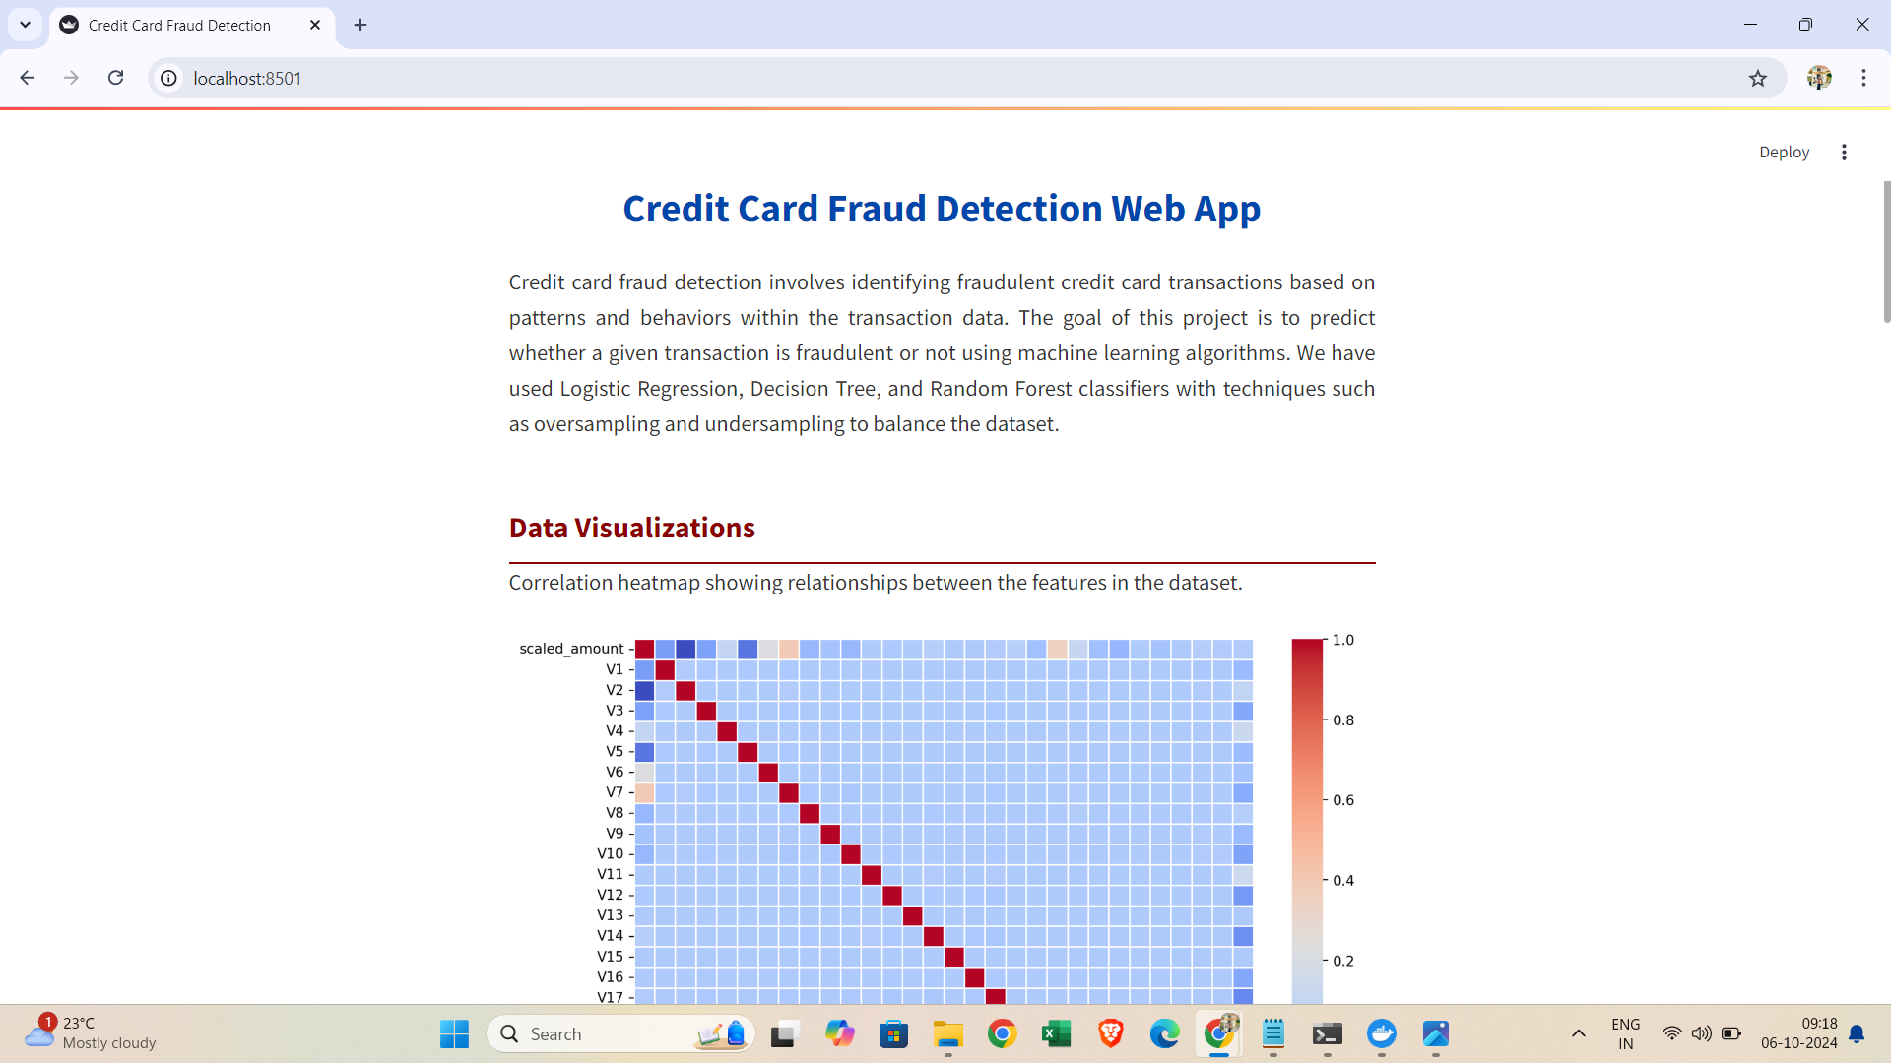
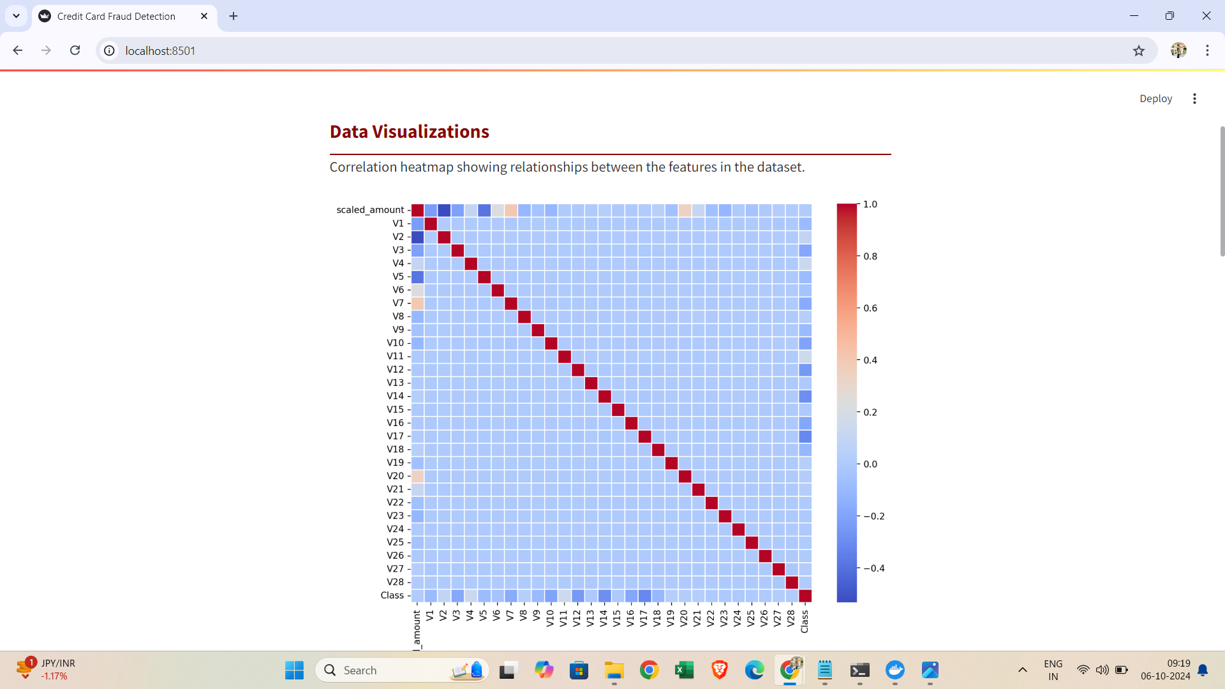
Images of Project
Web App Images on localhost:8501

Slide 12
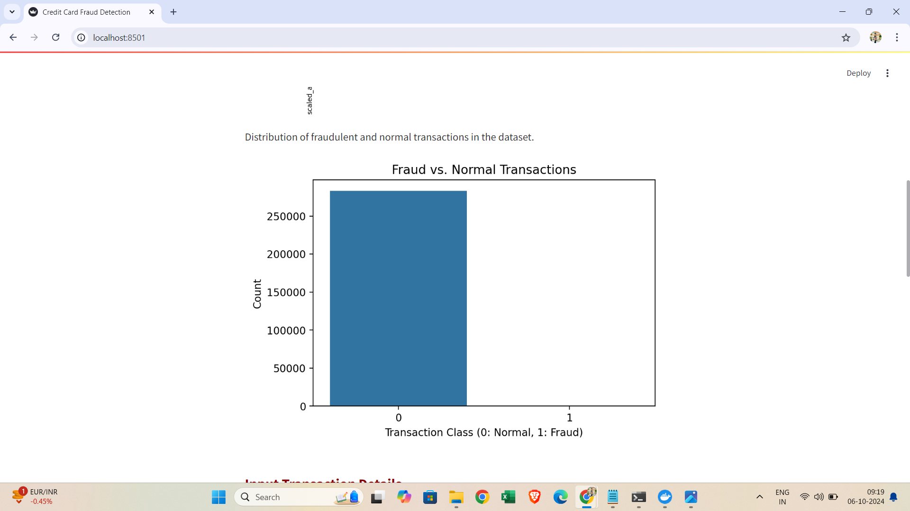
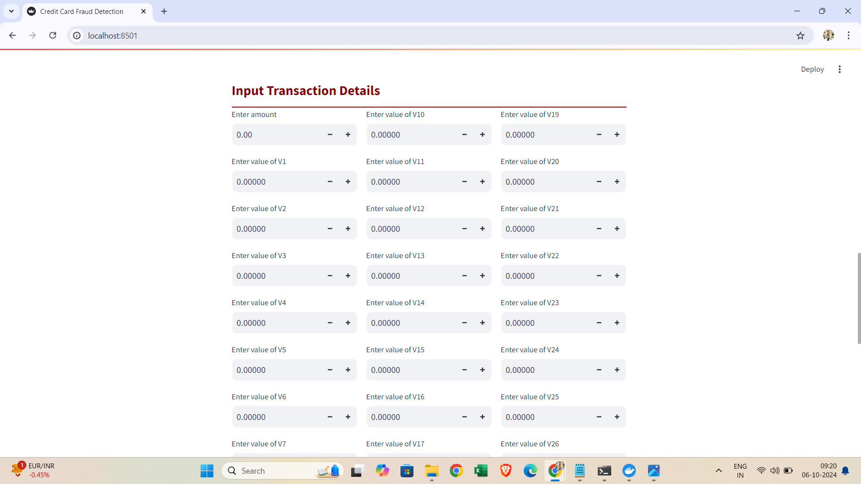
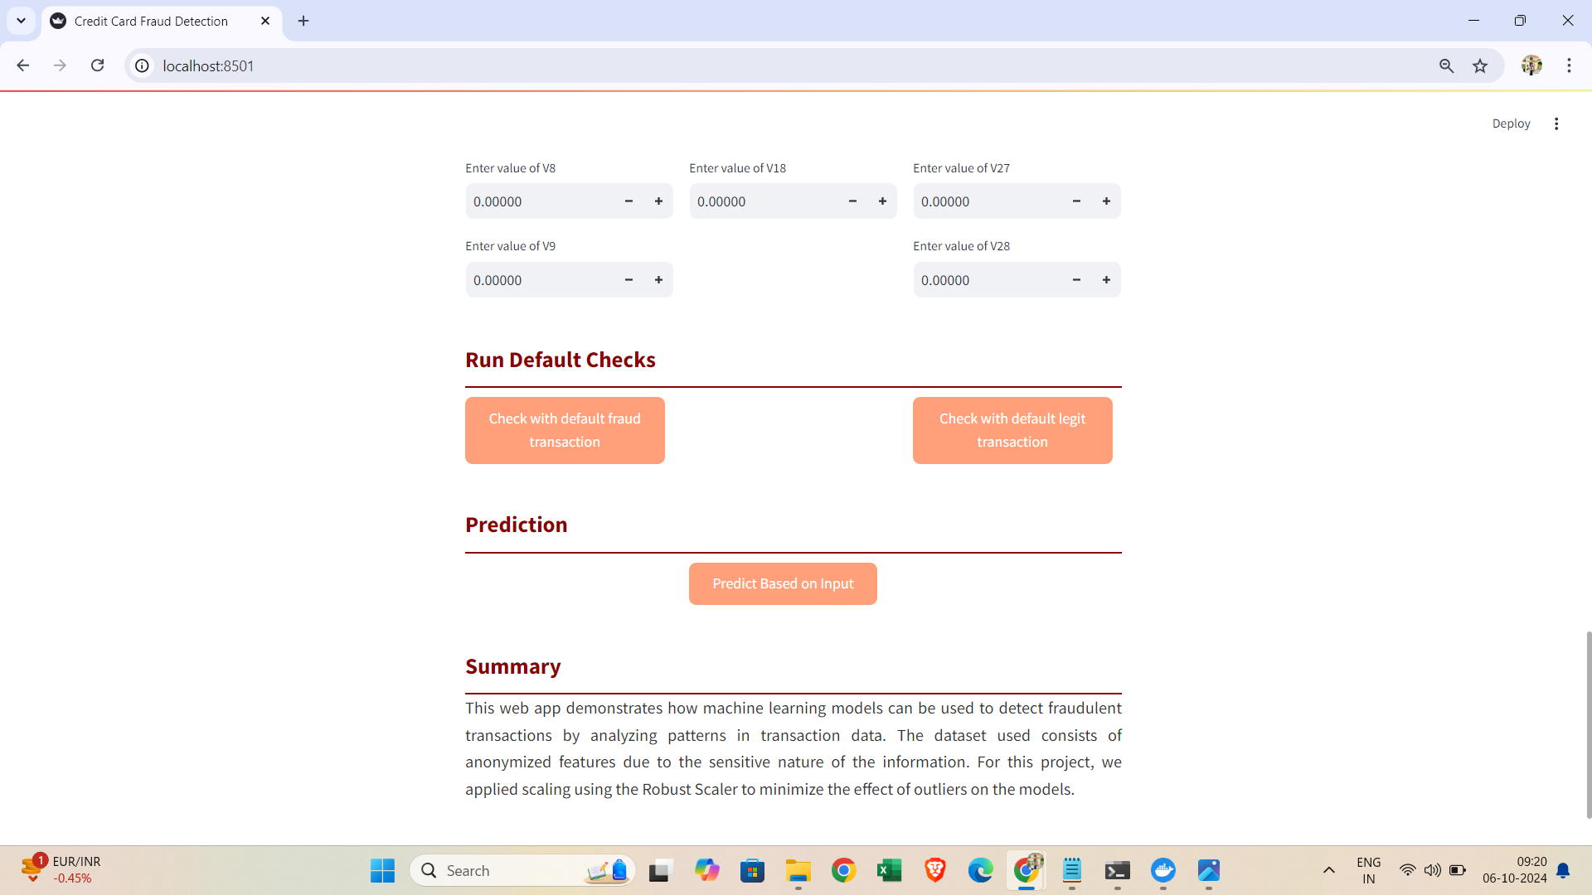
Images of Project
Web App Images on localhost:8501

Slide 13
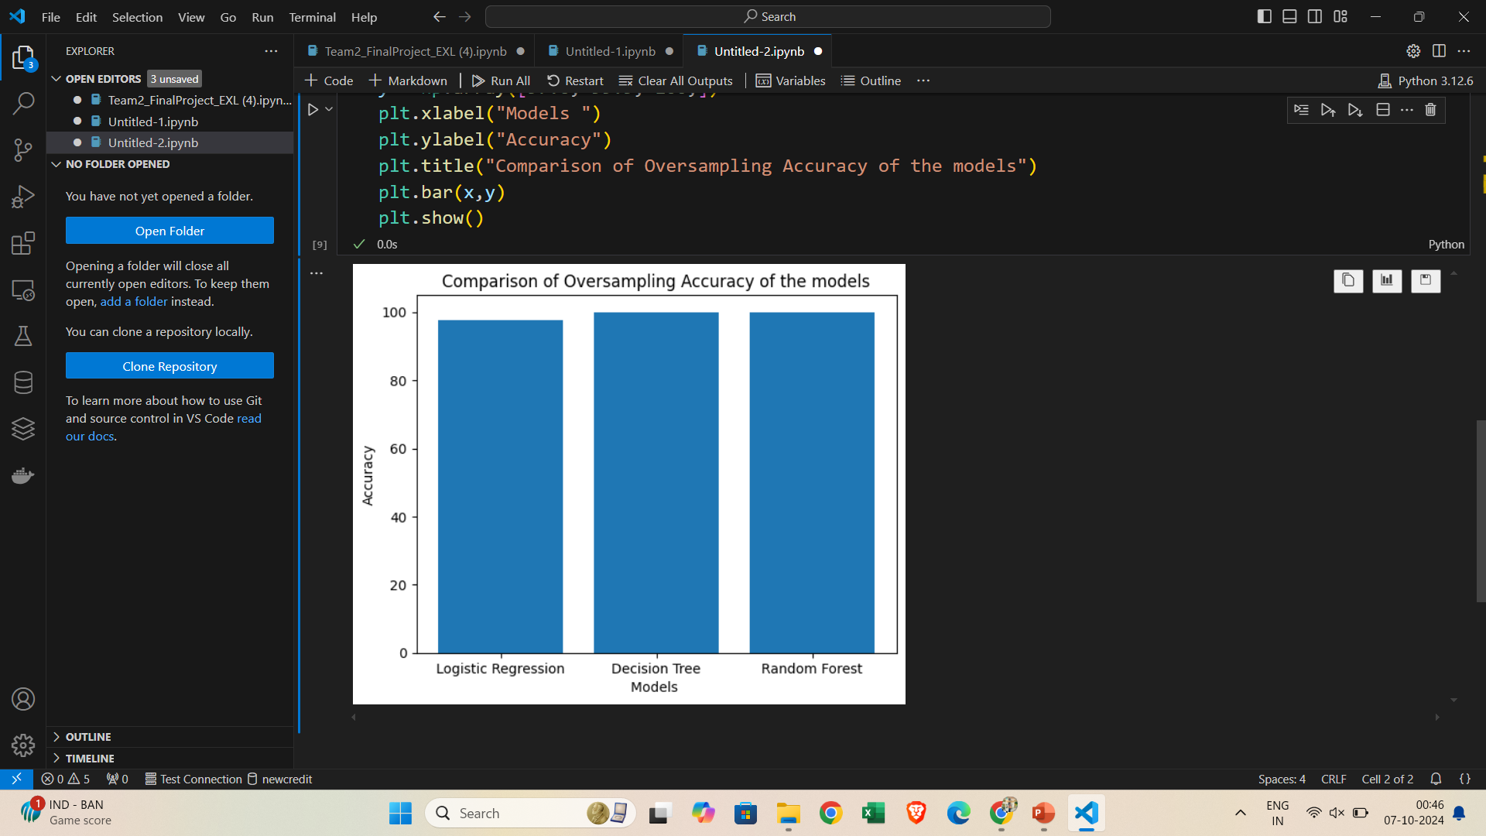
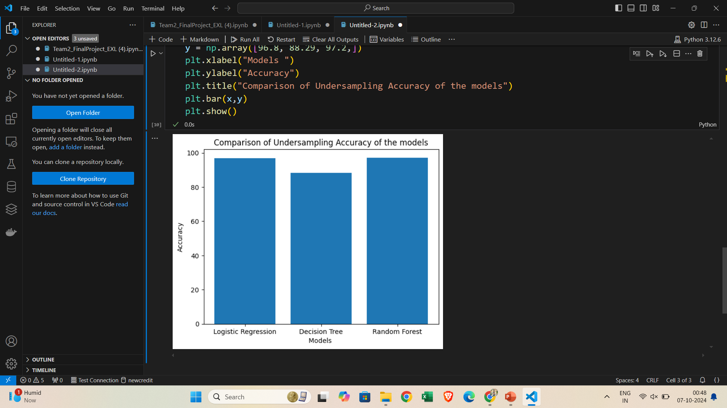
Comparison of models using Oversampling and Undersampling

Slide 14
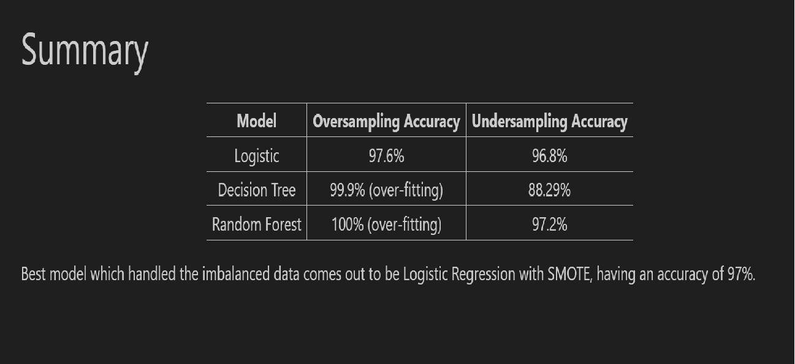
Images of Project
Accuracy obtained using the models :

Slide 15
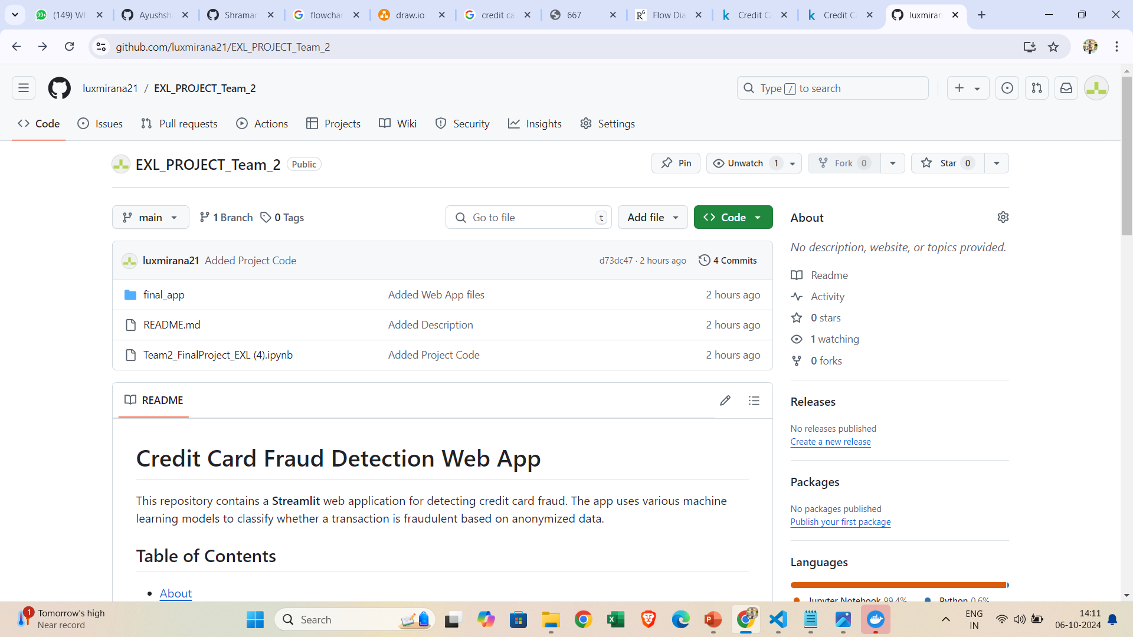
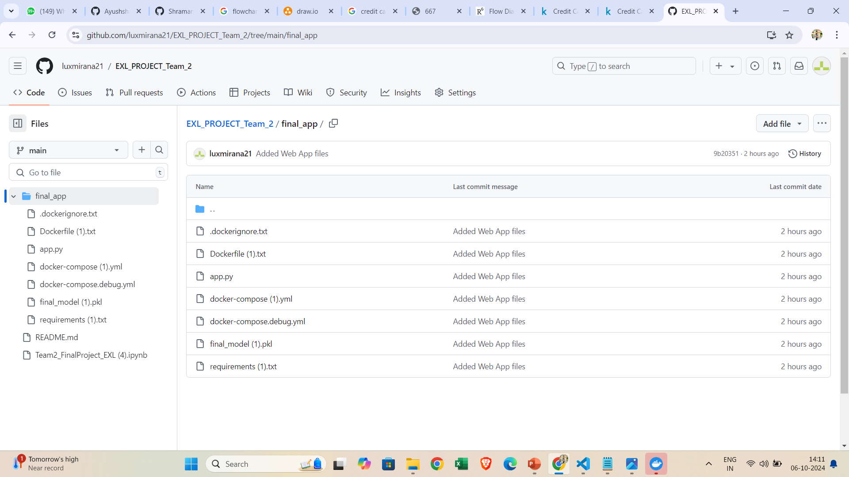
Images of Project
Git Hub :

